Slide 1
Developing Rubrics to Measure Learning at MICA
Jonathan Latiano
Alisha Green

Slide 2
Workshop Goals
Participants will learn:
  How and why rubrics are used in higher ed.
  How rubrics are being used at MICA
  Best practices for rubric writing
Rubric writing exercise
Examples and questions from your courses & programs/departments

Slide 3
How and why we use rubrics in higher ed.
Rubric: A scoring guide that describes the criteria that you will use to evaluate/grade a student assignment or activity
Rubrics help you…
  clarify vague, fuzzy learning goals (e.g. “communication skills”)
  provide better feedback to students
  score/grade more easily and efficiently
  be prepared for annual assessment reporting
  self-improve
Rubrics help your students…
  understand your expectations and teaching style
  understand the assignment and why it’s important to their learning
  know exactly what they need to improve
  link the assignment to learning in other classes and in the co-curricular (synthesized learning)
  put into perspective their own strengths and weaknesses within the individual assignment as well as the overall semester

Slide 4
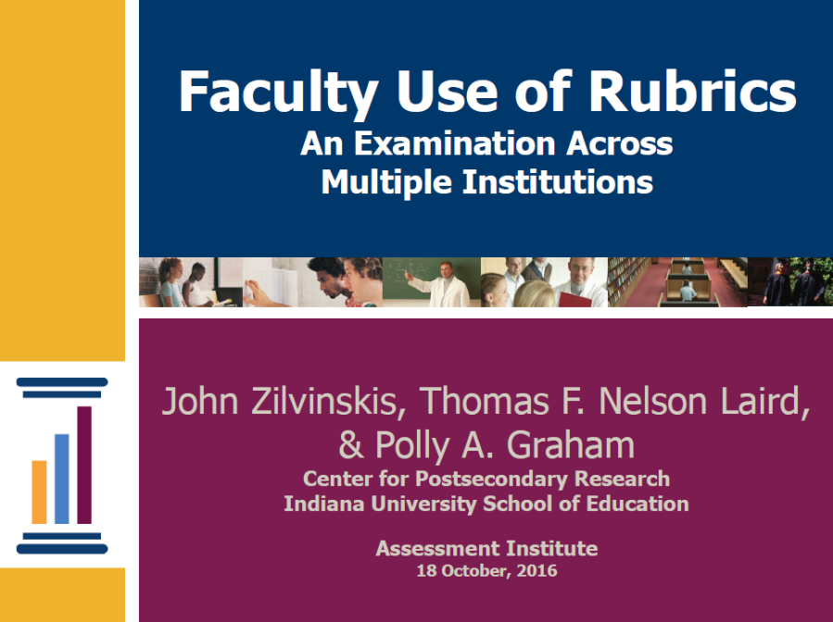
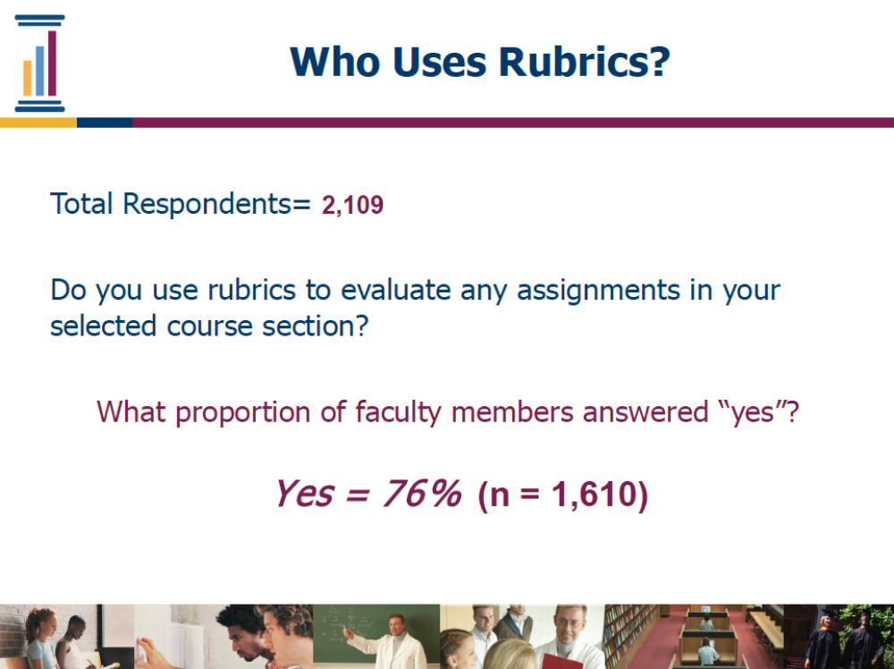

Slide 5
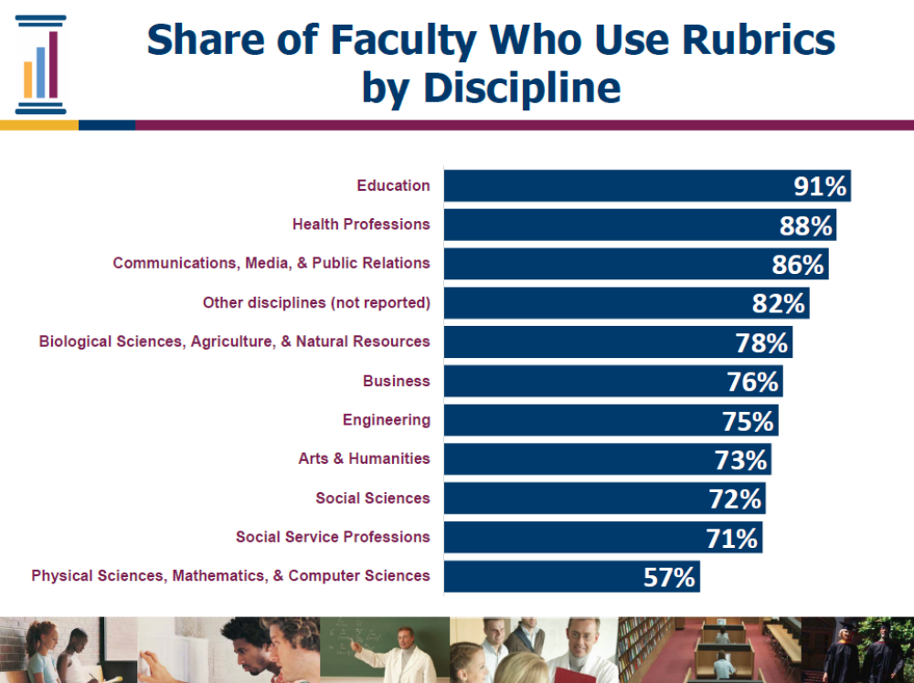

Slide 6
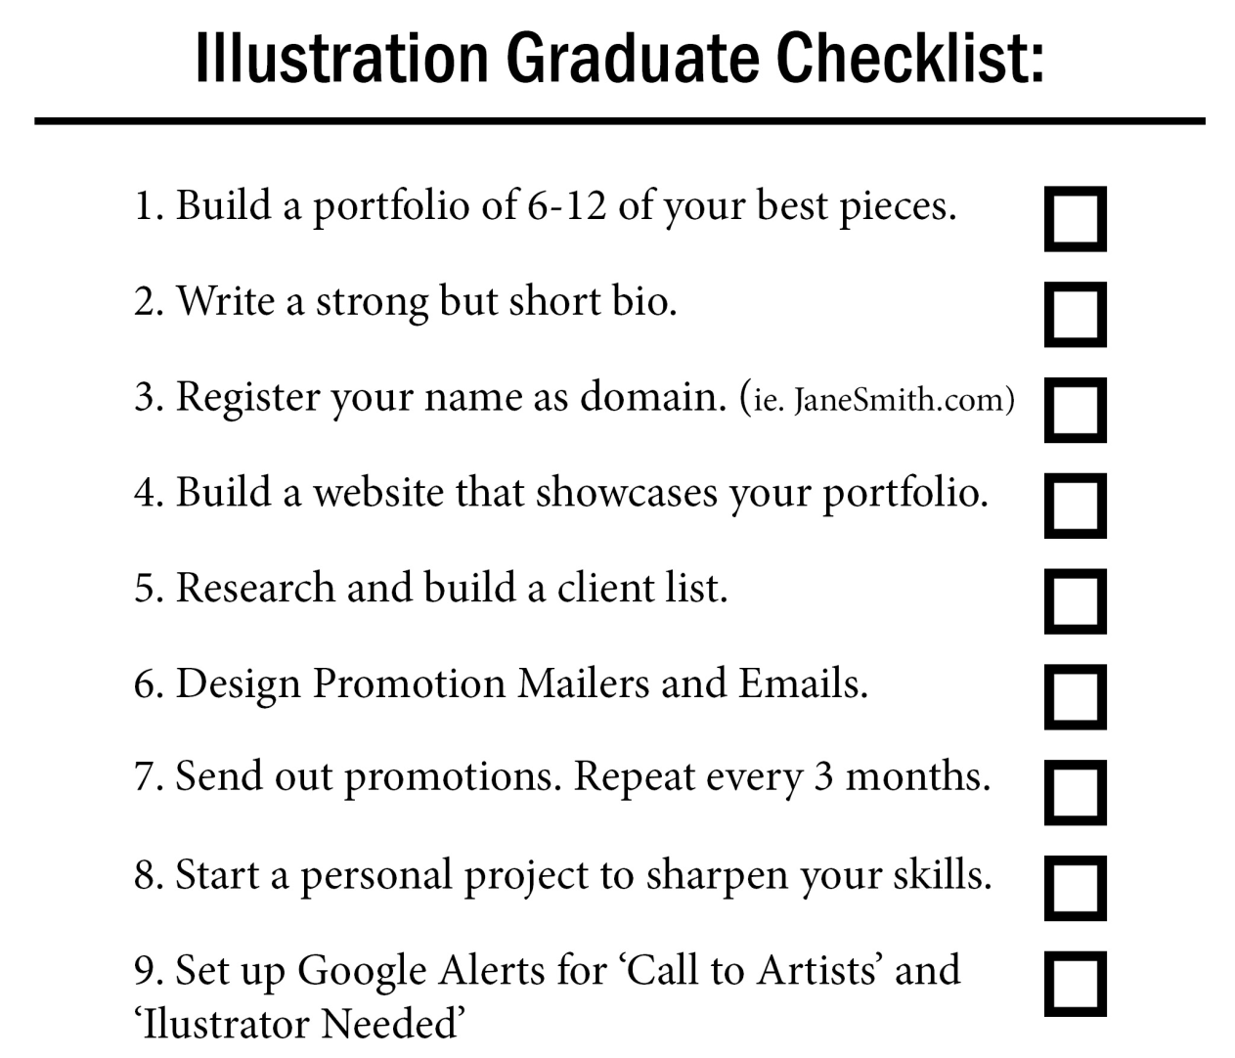
Types of Rubrics
Checklist

Slide 7
Types of Rubrics
Checklist
Holistic
Points | Description
4 | Student’s understanding of concept is clearly evident Student uses effective strategies to get accurate results Student uses logical thinking to arrive at conclusion
3 | Student’s understanding of the concept is evident Student uses appropriate strategies to arrive at a result Student shows thinking skills to arrive at conclusion
2 | Student has limited understanding of a concept Student uses strategies that are ineffective Student attempts to show thinking skills
1 | Student has a complete lack of understanding of concept Student makes no attempt to use a strategy Student shows no understanding

Slide 8
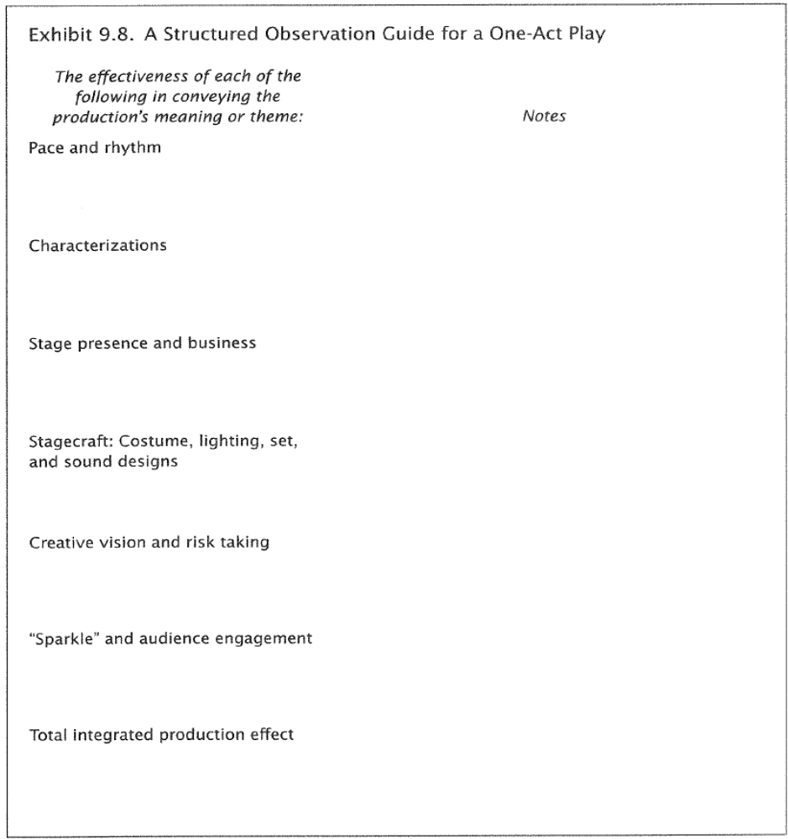
Types of Rubrics
Checklist
Holistic
Structured
Observation

Slide 9
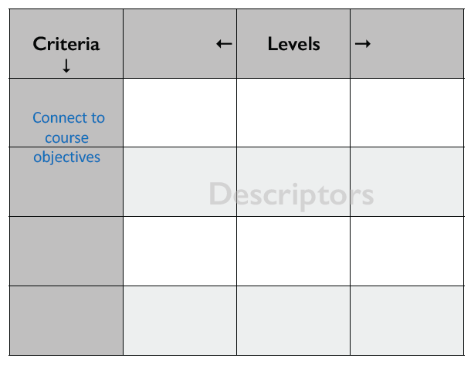
Types of Rubrics
Checklist
Holistic
Structured
Observation
Rating Scale
  (most common type
  used for MICA’s
  annual assessment
  reports)

Slide 10
How Rubrics are Used at MICA
For annual assessment of Student Learning Outcomes (SLOs)
  see handouts for examples
For assignment grading
  examples from Jonathan’s classes

Slide 11
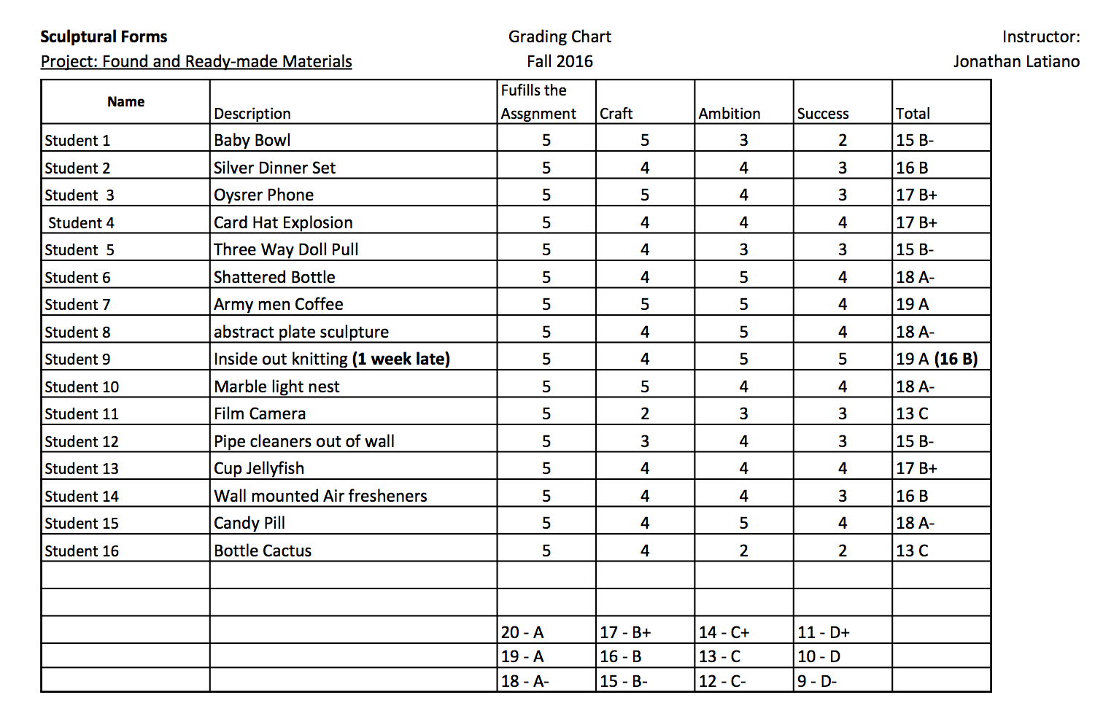
Types of Rubrics
Rating Scale Example:

Slide 12
Best Practices in Rubric Writing
Make sure the activity/assignment is aligned with your SLO(s)
  SLO: “Students will be able to apply the foundational elements and principles of the design process.”
  Assignment Rubric: “Successfully apply elements of the design process”
    15% of grade on the assignment
Example

Slide 13
 | Accomplished | Proficient | Developing | Novice
Successfully applied elements of the design process (15%)
Dana Scott, Philadelphia University
Opportunity Project Rubric

Slide 14
Best Practices in Rubric Writing
Make sure the activity/assignment is aligned with your SLO(s)
Think of the characteristics, skills, or behaviors that you are looking for in this particular student work/activity (and what you’re not looking for)
  Variation in approach
  Human-centered
  Logical sequence
  Did research
Example

Slide 15

Best Practices in Rubric Writing
Make sure the activity/assignment is aligned with your SLO(s)
Think of the characteristics, skills, or behaviors that you are looking for in this particular student work/activity (and what you’re not looking for)
  Variation in approach
  Human-centered
  Logical sequence
  Did research
Write thorough descriptions for excellent (4) and poor (1) work for each attribute

Slide 16
 | Accomplished | Proficient | Developing | Novice
Successfully applied elements of the design process (15%) | Implemented varied and appropriate human-centered research techniques to accomplish a logical process. |  |  | Did not apply the elements of design process
Dana Scott, Philadelphia University
Opportunity Project Rubric

Slide 17
Best Practices in Rubric Writing
Make sure the activity/assignment is aligned with your SLO(s)
Think of the characteristics, skills, or behaviors that you are looking for in this particular student work/activity (and what you’re not looking for)
Write thorough descriptions for excellent (4) and poor (1) work for each attribute
Complete the rubric by describing the other levels on the continuum (2 &3) for each attribute

Slide 18
 | Accomplished | Proficient | Developing | Novice
Successfully applied elements of the design process (15%) | Implemented varied and appropriate human-centered research techniques to accomplish a logical process. | Implemented multiple human-centered research techniques that were usually logically sequenced. | Implemented a few human centered research techniques and often did not follow a logical and progressive sequence. | Did not apply the elements of design process
Dana Scott, Philadelphia University
Opportunity Project Rubric

Slide 19
Best Practices in Rubric Writing
Make sure the activity/assignment is aligned with your SLO(s)
Think of the characteristics, skills, or behaviors that you are looking for in this particular student work/activity (and what you’re not looking for)
Write thorough descriptions for excellent (4) and poor (1) work for each attribute
Complete the rubric by describing the other levels on the continuum (2 &3) for each attribute
Repeat for each criteria for the assignment

Slide 20
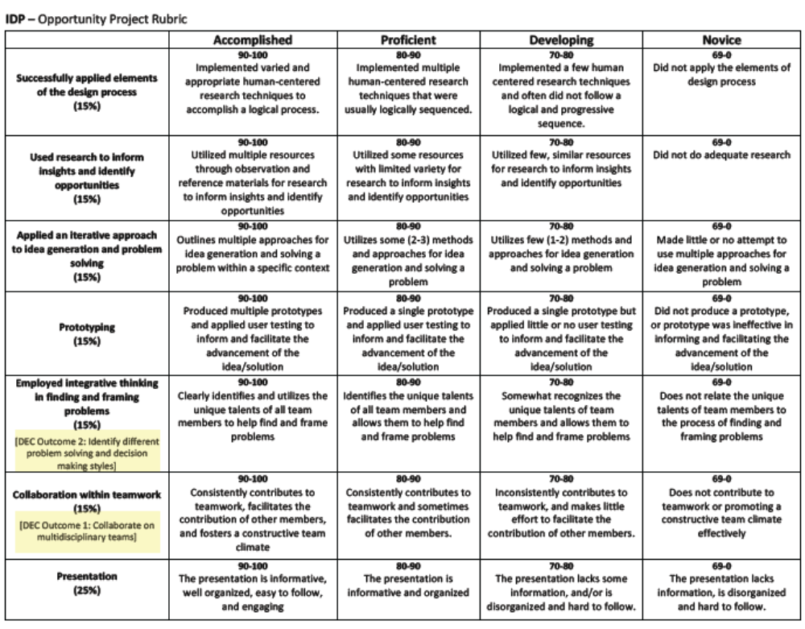
Dana Scott, Philadelphia University

Slide 21
Best Practices in Rubric Writing
Be sure to…
  Use Bloom’s Taxonomy Action Verbs
  Check out MICA’s assessment webpage and assessment archive for examples and guides
  Revise your rubrics
    “Don’t let the perfect be the enemy of the good!” – Voltaire
  Allow yourself some flexibility. Rubrics are not always dead-on (especially in the fine arts.)

Slide 22

Rubric Writing Exercise
You are faculty members at the Maryland Institute of Culinary Arts. You’ve been asked to create a rubric for your Confections course.
  Student assignment: “Create the best new candy.”
  Rubric: Must measure 4 criteria, with 4 levels of achievement for each.

Slide 23
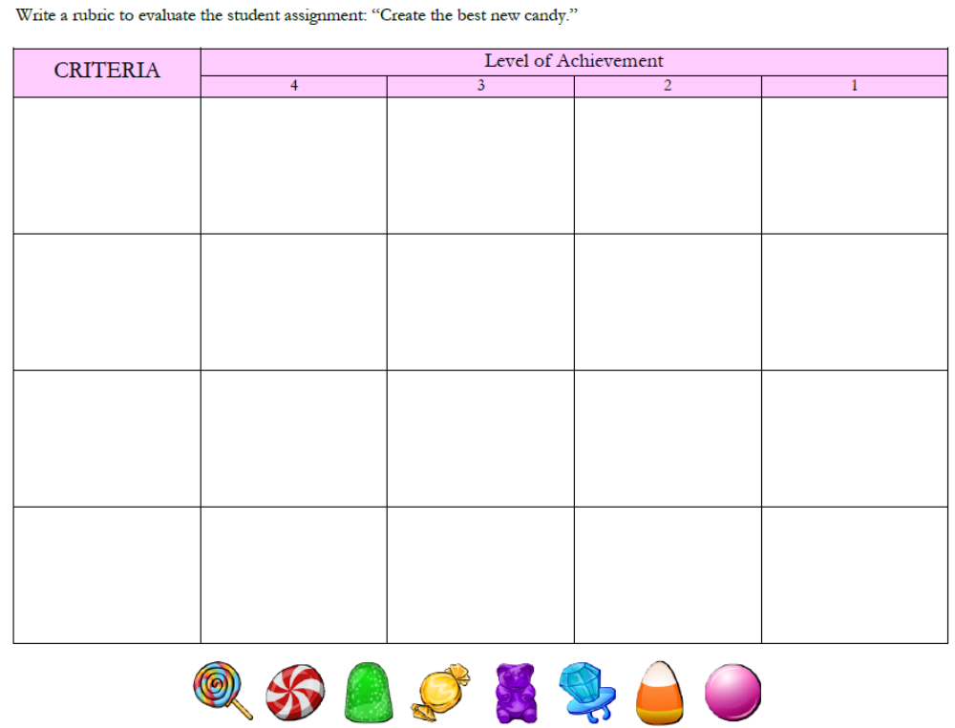

Slide 24
Examples and questions from your courses & programs/departments
Contact us:
Alisha Green- agreen@mica.edu
Jonathan Latiano- jlatiano@mica.edu

